Slide 1

Predicting Student Grades
Vinh Van

Slide 2
Objective
Using multivariate linear regression analysis, my objective is to predict a student’s grade based on a large variety of variables relating to student demographics, socioeconomic circumstances and school-related factors

Slide 3
Why?
I wanted to see what factors, if any, play a large role in a student’s grades beyond the scope of conventional wisdom on the subject matter such as:
Amount of time spent studying
Attending every class
Prior grades

Slide 4
How did I do it?
Using R as the primary programming language and RStudio as the IDE, I analyzed a dataset of student’s final grades in secondary education. This dataset
Contained 393 unique entries
Had a total of 33 variables
Was acquired from Kaggle
There was no entries with missing values or discarded inputs. Therefore, all 393 entries were maintained.
References:
P. Cortez and A. Silva. Using Data Mining to Predict Secondary School Student Performance. In A. Brito and J. Teixeira Eds., Proceedings of 5th FUture BUsiness TEChnology Conference (FUBUTEC 2008) pp. 5-12, Porto, Portugal, April, 2008, EUROSIS, ISBN 978-9077381-39-7.

Slide 5
Variables
School – student’s school higher – wants to take higher education
Sex – student’s gender internet – Internet access at home
Age – Age of the student romantic – in a romantic relationship
Address – Student’s home address “type” famrel – quality of family relationship(1-5)
Famsize – student’s family size freetime – free time after school (1-5)
Pstatus – parent’s cohabitation status goout – going out with friends(1-5)
Medu – mother’s education Dalc – workday alcohol consumption(1-5)
Fedu – father’s education Walc – weekend alcohol consumption(1-5)
Mjob – mother’s job health – current health status(1-5)
Fjob – father’s job absences – number of school absences(0-93)
Reason – reason to choose schooling G1 – first period grade
Guardian – student’s guardian G2 – second period grade
Traveltime – home to school travel time G3 – final grade
Studytime – weekly study time
Failures – number of past failed classes
Schoolsup – extra educational support
Famsup – family educational support
Paid – extra paid classes within the course subject
Activities – extra-curricular activities
Nursery – attended nursery school

Slide 6
Variables
School – student’s school higher – wants to take higher education
Sex – student’s gender internet – Internet access at home
Age – Age of the student romantic – in a romantic relationship
Address – Student’s home address “type” famrel – quality of family relationship(1-5)
Famsize – student’s family size freetime – free time after school (1-5)
Pstatus – parent’s cohabitation status goout – going out with friends(1-5)
Medu – mother’s education Dalc – workday alcohol consumption(1-5)
Fedu – father’s education Walc – weekend alcohol consumption(1-5)
Mjob – mother’s job health – current health status(1-5)
Fjob – father’s job absences – number of school absences(0-93)
Reason – reason to choose schooling G1 – first period grade
Guardian – student’s guardian G2 – second period grade
Traveltime – home to school travel time G3 – final grade
Studytime – weekly study time
Failures – number of past failed classes
Schoolsup – extra educational support
Famsup – family educational support
Paid – extra paid classes within the course subject
Activities – extra-curricular activities
Nursery – attended nursery school

Slide 7
Dummy Variables
School – student’s school higher – wants to take higher education
Sex – student’s gender internet – Internet access at home
Age – Age of the student romantic – in a romantic relationship
Address – Student’s home address “type” famrel – quality of family relationship(1-5)
Famsize – student’s family size freetime – free time after school (1-5)
Pstatus – parent’s cohabitation status goout – going out with friends(1-5)
Medu – mother’s education Dalc – workday alcohol consumption(1-5)
Fedu – father’s education Walc – weekend alcohol consumption(1-5)
Mjob – mother’s job health – current health status(1-5)
Fjob – father’s job absences – number of school absences(0-93)
Reason – reason to choose schooling G1 – first period grade
Guardian – student’s guardian G2 – second period grade
Traveltime – home to school travel time G3 – final grade
Studytime – weekly study time
Failures – number of past failed classes
Schoolsup – extra educational support
Famsup – family educational support
Paid – extra paid classes within the course subject
Activities – extra-curricular activities
Nursery – attended nursery school

Slide 8
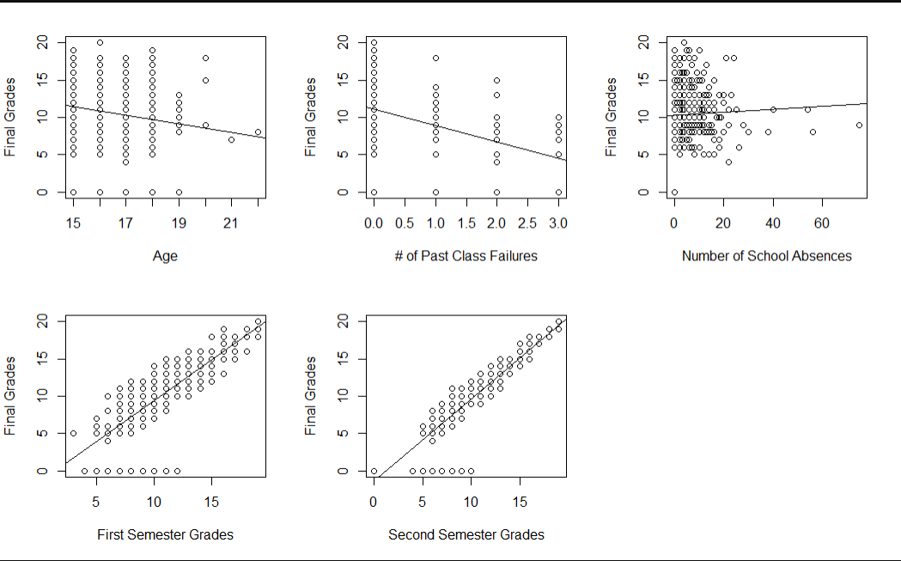
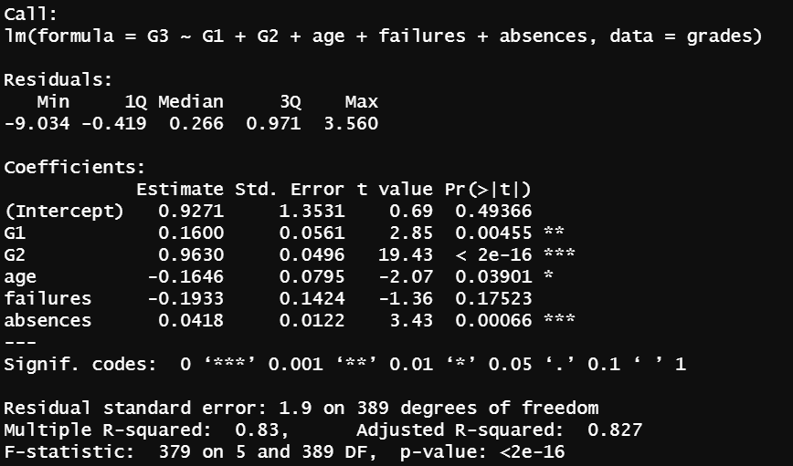
Initial Model
$${\hat{Y}=B}_{0}+B_{1}\left(G1\right)+B_{2}\left(G2\right)+B_{3}\left(Age\right)+B_{4}\left(failures\right)+B_{5}(absences)$$

Slide 9
Collinearity
Creating a Correlation Matrix
 | G3 | G1 | G2 | Age | Failures | Absences
G3 | 1 | 0.801 | 0.905 | -0.162 | -0.360 | 0.034
G1 | 0.801 | 1 | 0.852 | -0.064 | -0.355 | -0.031
G2 | 0.905 | 0.852 | 1 | -0.143 | -0.356 | -0.032
Age | -0.162 | -0.064 | -0.143 | 1 | 0.244 | 0.175
Failures | -0.360 | -0.355 | -0.356 | 0.244 | 1 | 0.064
Absences | 0.034 | -0.031 | -0.032 | 0.175 | 0.064 | 1

Slide 10
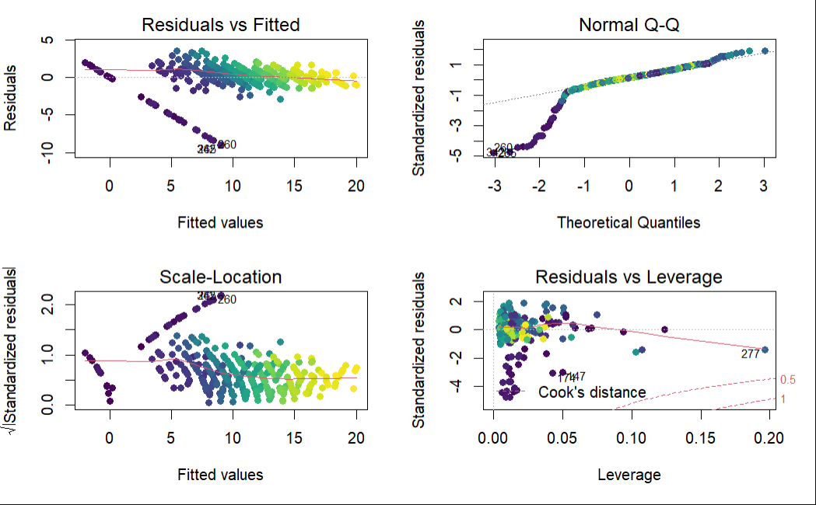
Collinearity
To test for Collinearity, I performed a VIF examination for each of the independent variables with critical value VIF>10
G1 | G2 | Age | Failures | Absences
3.8 | 3.8 | 1.1 | 1.2 | 1.0
Diagnostic Plots

Slide 11
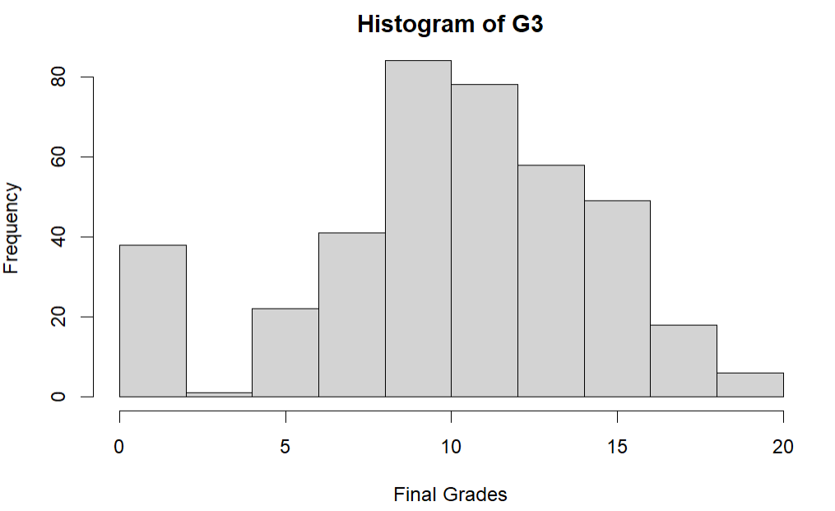
Transforming the Model
G3
Min: 0
1st Quartile: 8
Median: 11
Mean: 10.4
3rd Quartile: 14
Max: 20
We need to transform the model…

Slide 12
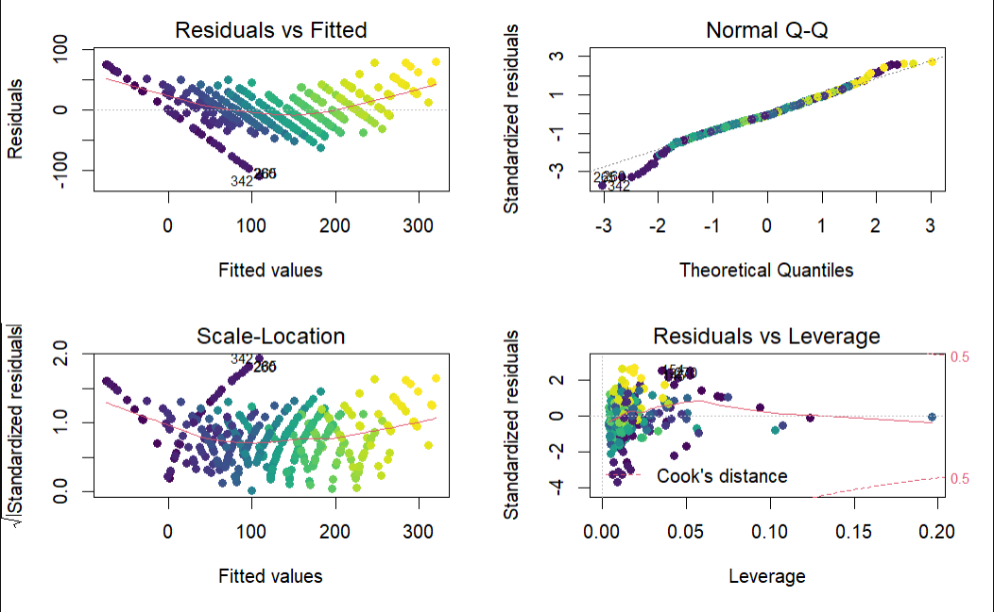
Transforming the Model
I decided to go with a Square transformation because it deals with left-skewedness the best out of all the transformations.
$${{\hat{Y(G3)}}^{2}=B}_{0}+B_{1}\left(G1\right)+B_{2}\left(G2\right)+B_{3}\left(Age\right)+B_{4}\left(failures\right)+B_{5}(absences)$$
Initial Model
Transformed Model

Slide 13
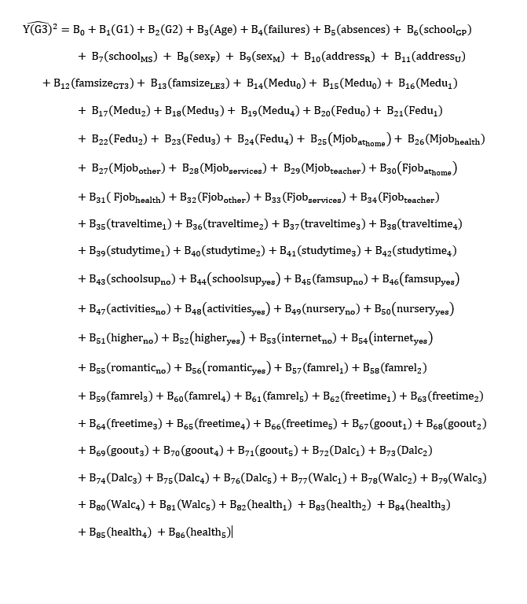
Adding the Dummy Variables

Slide 14
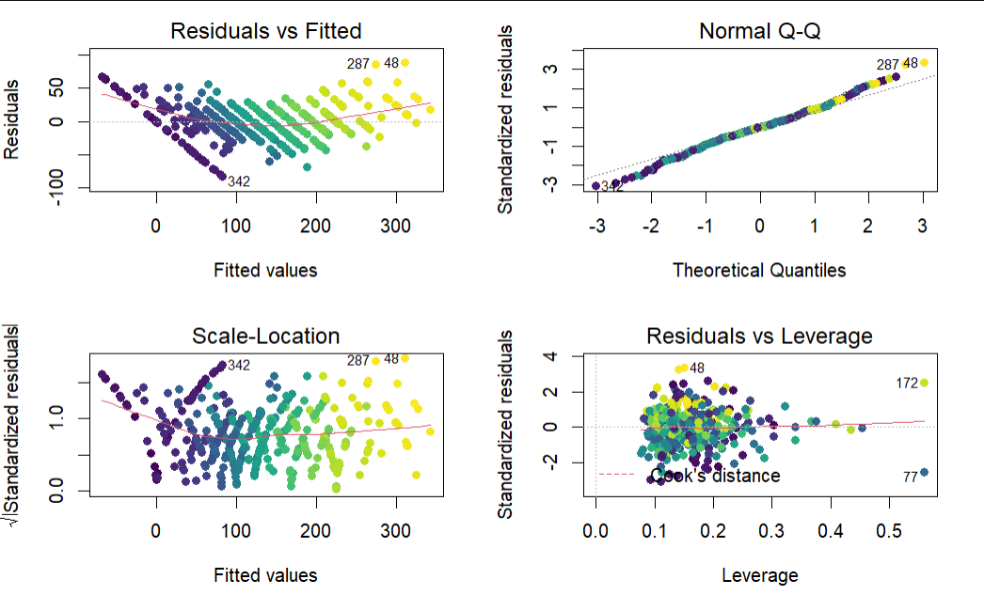
Adding the Dummy Variables

Slide 15
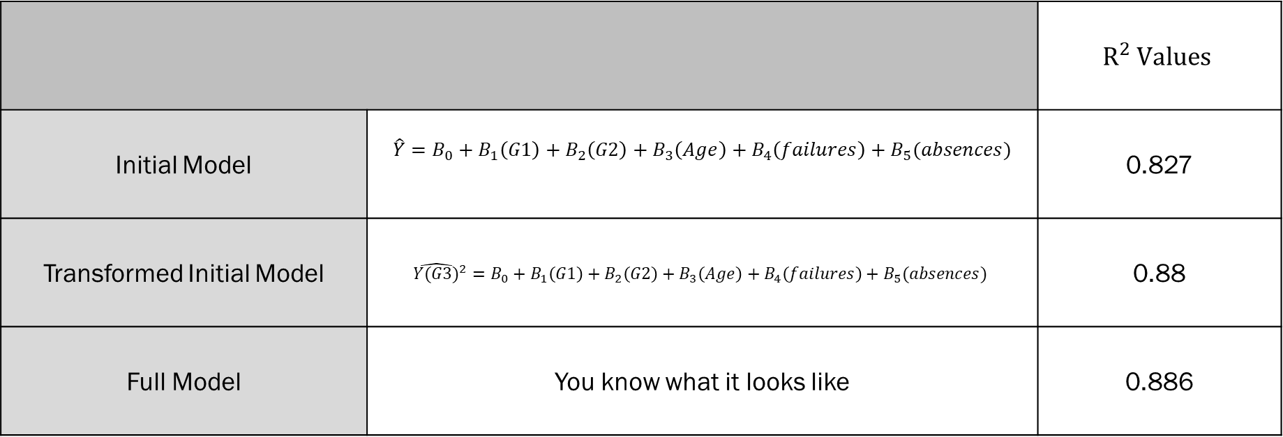
Progress Report
 |  | $$R^{2} Values$$
Initial Model | $${\hat{Y}=B}_{0}+B_{1}\left(G1\right)+B_{2}\left(G2\right)+B_{3}\left(Age\right)+B_{4}\left(failures\right)+B_{5}(absences)$$ | 0.827
Transformed Initial Model | $${{\hat{Y(G3)}}^{2}=B}_{0}+B_{1}\left(G1\right)+B_{2}\left(G2\right)+B_{3}\left(Age\right)+B_{4}\left(failures\right)+B_{5}(absences)$$ | 0.88
Full Model | You know what it looks like | 0.886

Slide 16
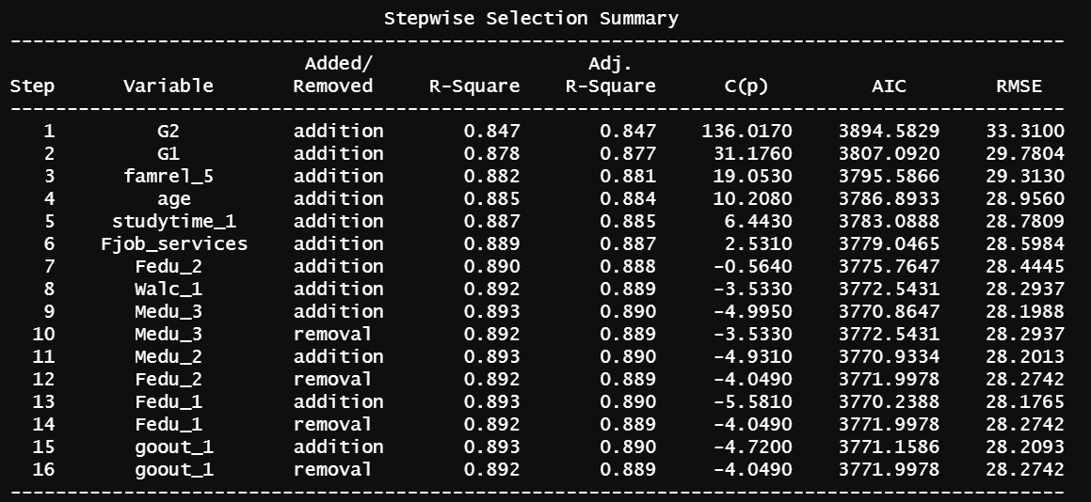
Stepwise Regression
I decided to go with Stepwise Regression with p-values because for a model so large, it would be the best candidate for thoroughness and would allow variables to added and then later removed if necessary.

Slide 17

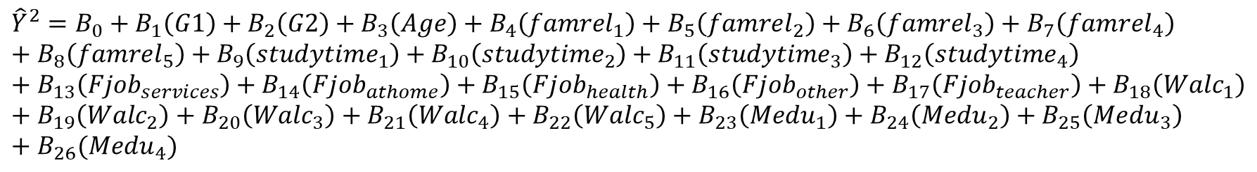
Stepwise Regression
Therefore, this would be my new model
$${{\hat{Y}}^{2}=B}_{0}+B_{1}\left(G1\right)+B_{2}\left(G2\right)+B_{3}\left(Age\right)+B_{4}\left(famrel_{5}\right)+B_{5}\left(studytime_{1}\right)+B_{6}\left(Fjob_{services}\right)+B_{7}\left({Walc}_{1}\right)+B_{8}({Medu}_{2})$$
Except that something was bothering me…
$${{\hat{Y}}^{2}=B}_{0}+B_{1}\left(G1\right)+B_{2}\left(G2\right)+B_{3}\left(Age\right)+B_{4}\left(famrel_{1}\right)+B_{5}\left(famrel_{2}\right)+B_{6}\left(famrel_{3}\right)+B_{7}\left(famrel_{4}\right)+B_{8}\left(famrel_{5}\right)+B_{9}\left(studytime_{1}\right)+B_{10}\left(studytime_{2}\right)+B_{11}\left(studytime_{3}\right)+B_{12}\left(studytime_{4}\right)+B_{13}\left(Fjob_{services}\right)+B_{14}\left(Fjob_{athome}\right)+B_{15}\left(Fjob_{health}\right)+B_{16}\left(Fjob_{other}\right)+B_{17}\left(Fjob_{teacher}\right)+B_{18}\left(Walc_{1}\right)+B_{19}\left(Walc_{2}\right)+B_{20}\left(Walc_{3}\right)+B_{21}\left(Walc_{4}\right)+B_{22}\left(Walc_{5}\right)+B_{23}\left(Medu_{1}\right)+B_{24}\left(Medu_{2}\right)+B_{25}\left(Medu_{3}\right)+B_{26}(Medu_{4})$$
This would be my final reduced model. I used anova(model1,model2) to verify validity of my model.

Slide 18
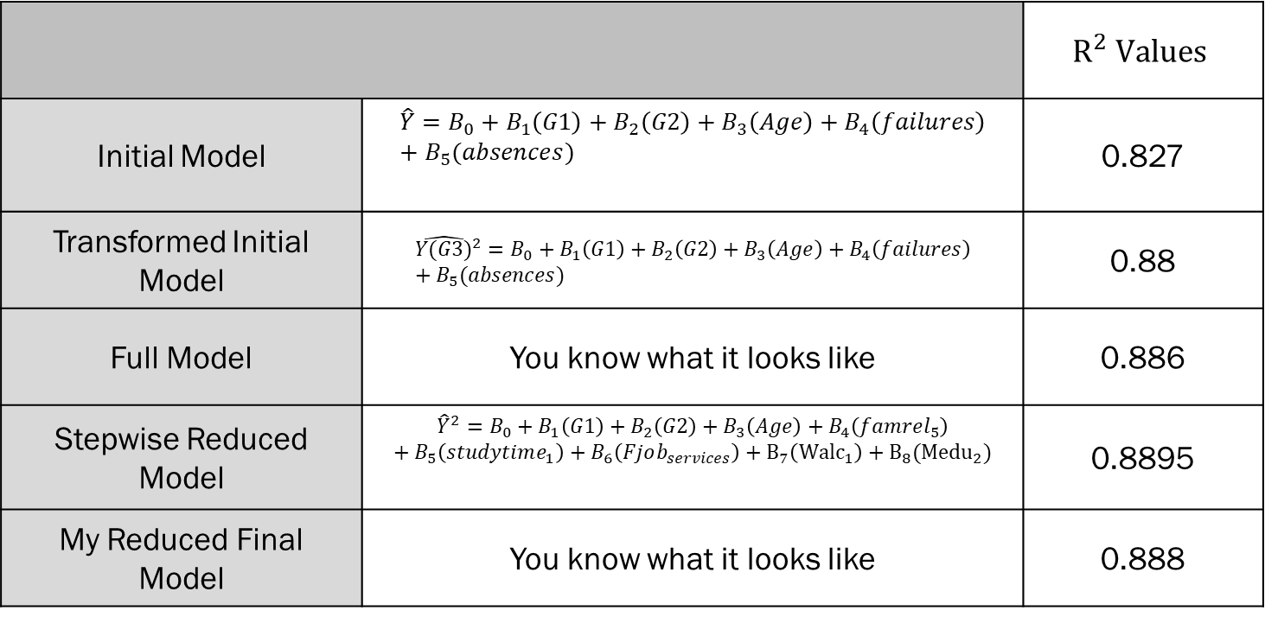
Comparing Models
 |  | $$R^{2} Values$$
Initial Model | $${\hat{Y}=B}_{0}+B_{1}\left(G1\right)+B_{2}\left(G2\right)+B_{3}\left(Age\right)+B_{4}\left(failures\right)+B_{5}(absences)$$ | 0.827
Transformed Initial Model | $${{\hat{Y(G3)}}^{2}=B}_{0}+B_{1}\left(G1\right)+B_{2}\left(G2\right)+B_{3}\left(Age\right)+B_{4}\left(failures\right)+B_{5}(absences)$$ | 0.88
Full Model | You know what it looks like | 0.886
Stepwise Reduced Model | $${{\hat{Y}}^{2}=B}_{0}+B_{1}\left(G1\right)+B_{2}\left(G2\right)+B_{3}\left(Age\right)+B_{4}\left(famrel_{5}\right)+B_{5}\left(studytime_{1}\right)+B_{6}\left(Fjob_{services}\right)+B_{7}\left({Walc}_{1}\right)+B_{8}({Medu}_{2})$$ | 0.8895
My Reduced Final Model | You know what it looks like | 0.888

Slide 19
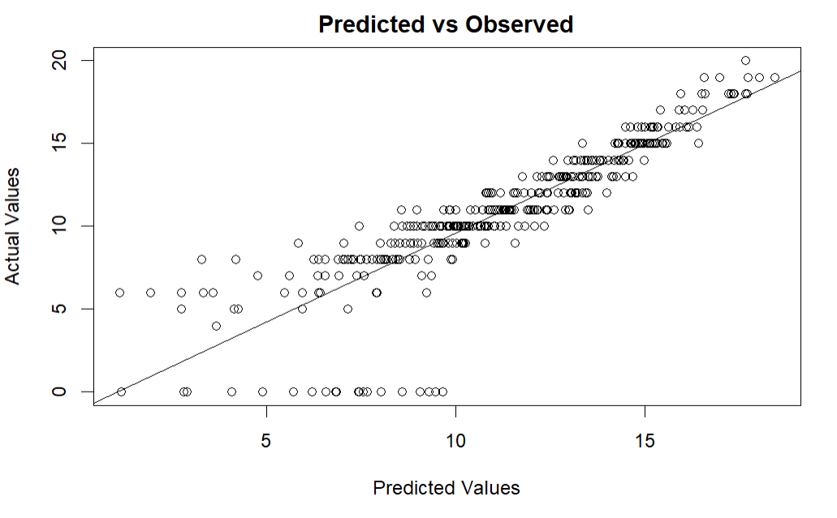
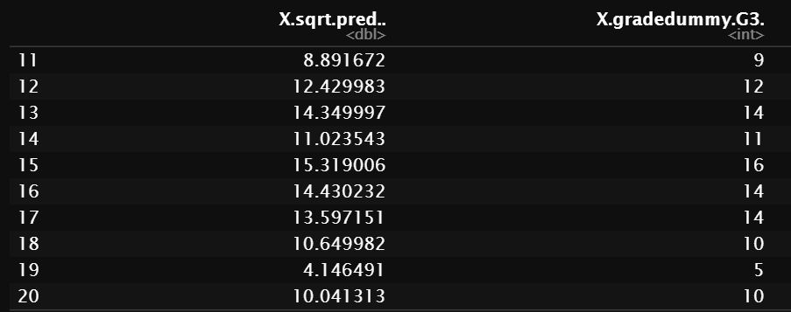
Predicted vs Observed

Slide 20
Limitations
There are a couple limitations I want to highlight
Because I am not the one that personally collected the data, there are certain variables or outcomes that I just have no control over because I don’t know the methods of collection that was used to gather this data. This makes it a bit trickier to assign significance to some of the categorical variables because you can only work with what you’re given.
The scope of the dataset is limited so I had to be careful about my interpretations/validity of some of the variables and oftentimes make educated judgements about the data.

Slide 21
Conclusions and Interpretation
Conclusion
Based on my model using multivariate linear regression, there is enough statistically significant evidence to suggest that Previous Semester Grades, Age, Family Relationship, Weekly Study Time, Weekend Alcohol Consumption, Paternal Employment and Maternal Education are predictors for a Student’s Final Grades.
Interpretation
Based on my model the next time you think about passing your finals, instead of studying, consider the following:
Bonding with your family (p-value = 0.000184)
Ask your father if it’s time to ask his boss for a promotion (p-value = 0.02)
Ask your mother why she never got her Masters Degree (p-value = 0.015)

